Slide 1
Zombies everywhere: Digging deeper to understand the habit of procrastination
Barbara Oakley, PhD

Slide 2
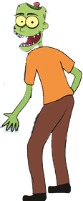
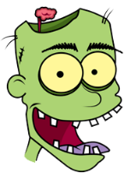
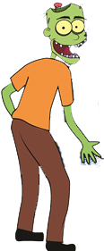

Habits have four parts:
The cue
The routine
The reward
The belief

Slide 3
Image Credits
Woman backing up in the car courtesy Rachel Oakley.
Man riding a bicycle courtesy Philip Oakley.
Zombie illustrations ©Kevin Mendez, 2014.
Clip art courtesy Microsoft Corporation
Relevant Readings
Boice, Robert. Procrastination and Blocking. Westport, CT: Praeger, 1996.
Duhigg, Charles. The Power of Habit. NY: Random House, 2012.
Fiore, Neil A. The Now Habit. NY: Penguin, 2007.
McClain, Dylan Loeb. "Harnessing the Brain's Right Hemisphere to Capture Many Kings." New York Times, Jan 24 2011.
Steel, Piers. "The Nature of Procrastination: A Meta-Analytic and Theoretical Review of Quintessential Self-Regulatory Failure." Psychological Bulletin 133, no. 1 (Jan 2007): 65-94.
———. The Procrastination Equation. NY: Random House, 2010.
Wan, X., H. Nakatani, K. Ueno, T. Asamizuya, K. Cheng, and K. Tanaka. "The Neural Basis of Intuitive Best Next-Move Generation in Board Game Experts." Science 331, no. 6015 (Jan 21 2011): 341-6.

